Slide 1
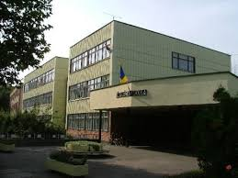
Tildy Zoltán Primary School and basci Basic School of Arts

Slide 2
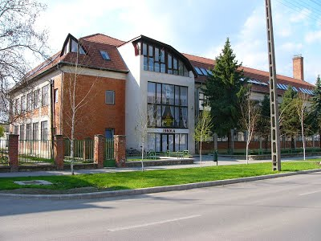
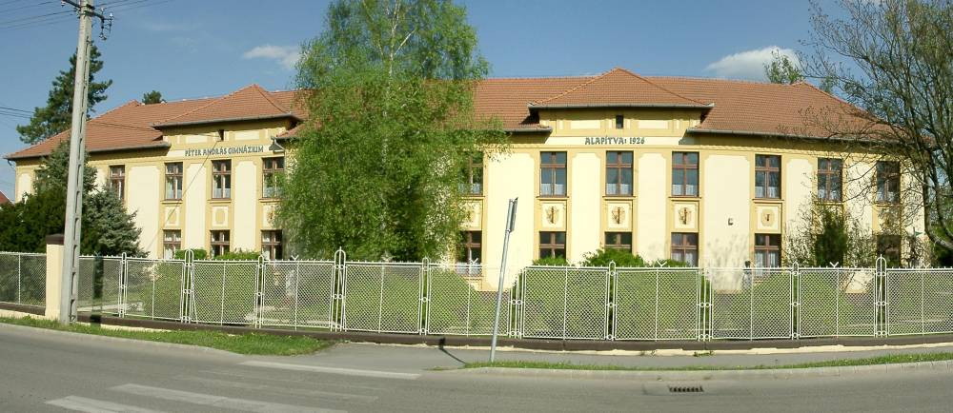
About our school
Our school consists of two buildings.
One building is for junior grades and the other one is for senior grades.
We go to primary school from 6 to 14 years old,but students may leave primary school in grade 6 and go to middle school. (They study the same subjects, but in a more detailed way).
There are about 247 pupils in the junior section, and about 256 pupils in the senior section.

Slide 3
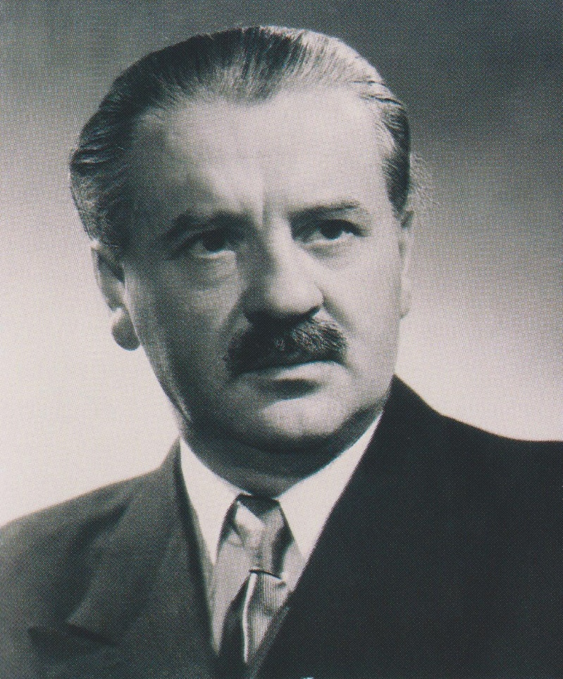
Our school’s denominator
Our school was named after Tildy Zoltán, who was a politician in Hungary. He was born in 1889 and died in 1961.
He was a calvinist priest in Szeghalom,
before he was nominated as Hungary’s
first prime minister.

Slide 4
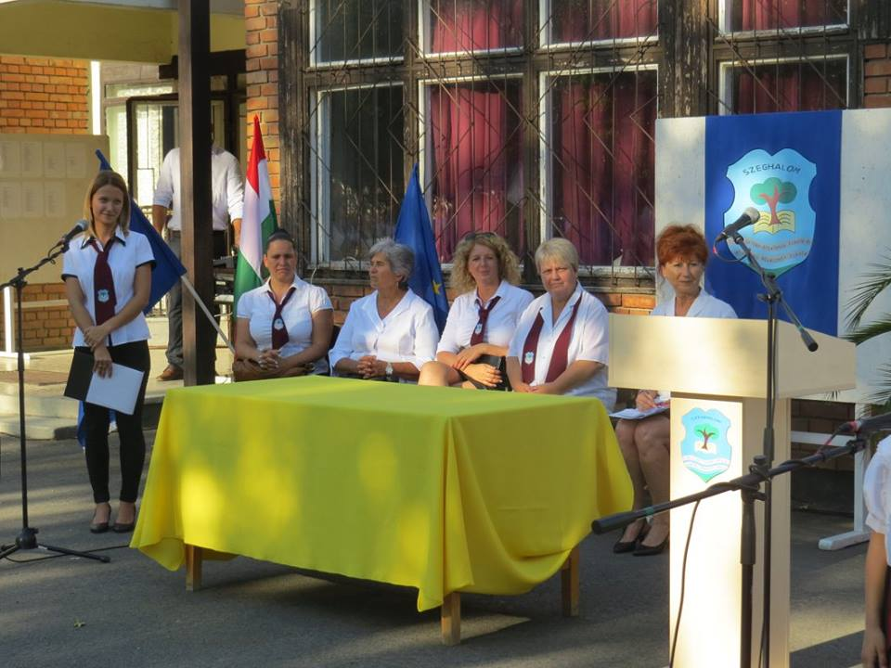
Directors
Sándorné Baji Anna
the deputy teacher in senior section
Vargáné Gajda Krisztina
the deputy teacher in Art school
Andrea Tagai the
Director

Slide 5
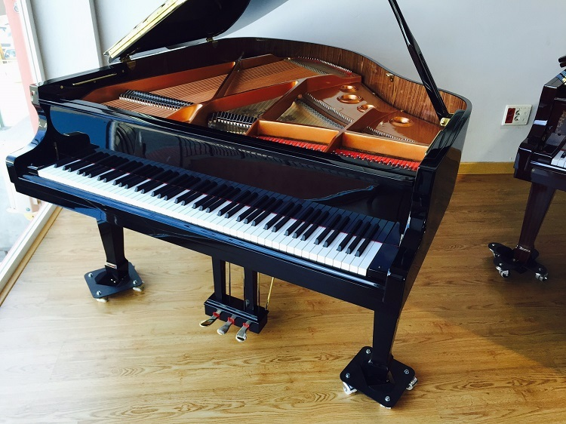
The school’s art department
We have 4 different categories of arts:
-acting
-dance
-music
-arts

Slide 6
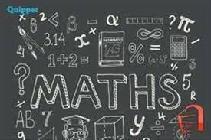
Subjects
Subjects in junior section: - Hungarian: Grammar, Reading, Writing, Composition
- Maths
- Enviroment
- Art
- Music
- Technology
- E
- English

Slide 7
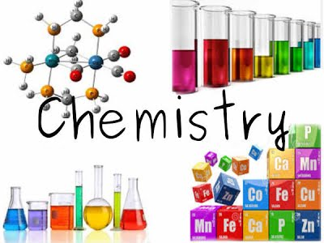
Subjects in the senior section: - Hungarian Literature,
- Hungarian Grammar
-Maths
-History
-Art
-Music
-Technology
-PE
-English,German
-From class 7:
Biology, Geography, Physics,
Chemistry

Slide 8
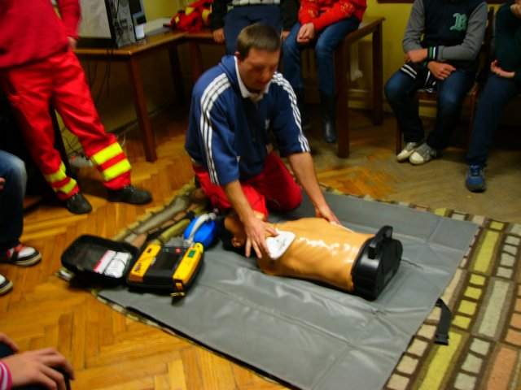
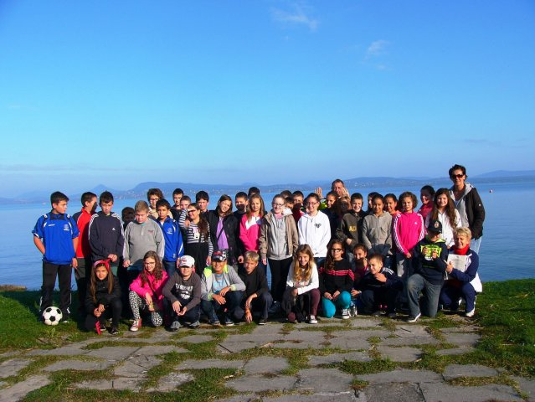
Student life
There are various activities from time to time in our school.
We usually have competitions in Maths, English, Dictation, Prose and ICT.
The eighth graders have a school disco. These parties are usually organized four times, but this year only three times.
We usually have a healthcare week every year in our school.
We have sometimes Erzsébet camp for the pupils.

Slide 9
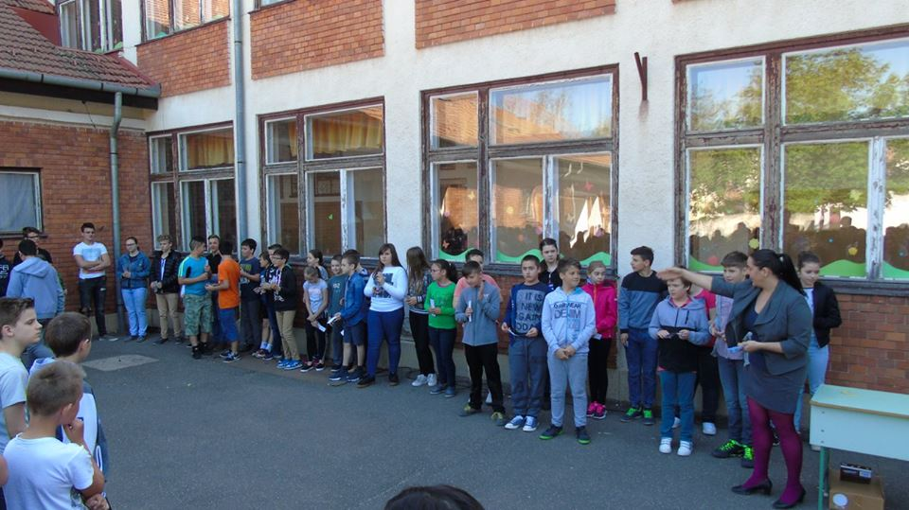
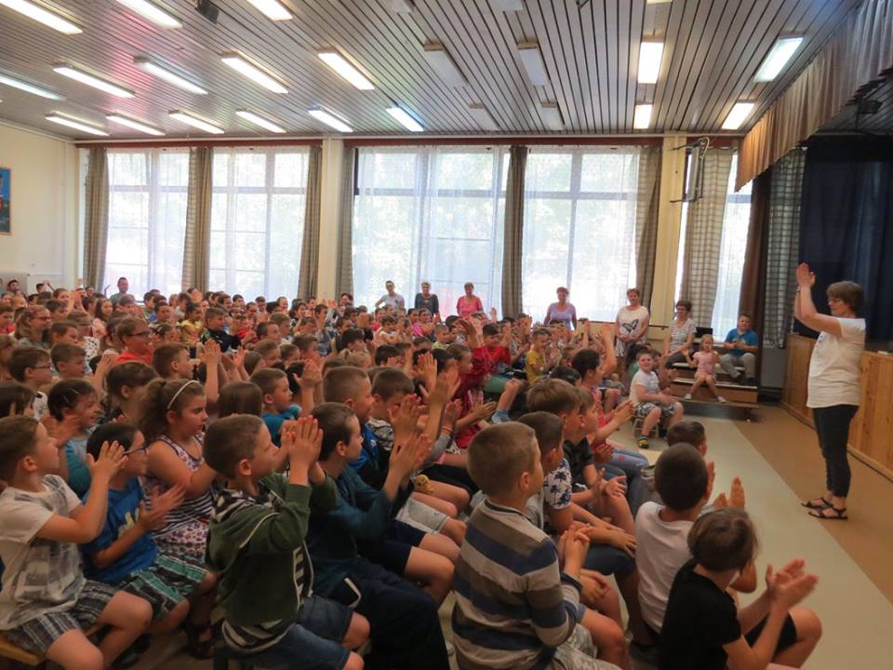
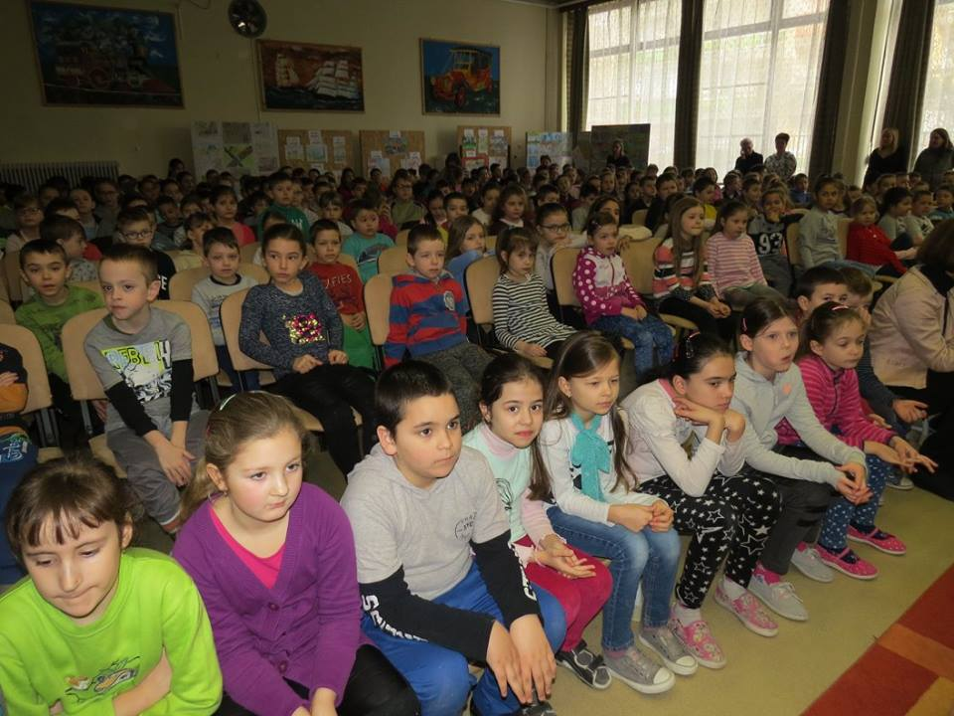
We usally have a school assembly, where we listen to results of competitions and outstanding pupils get rewards.

Slide 10
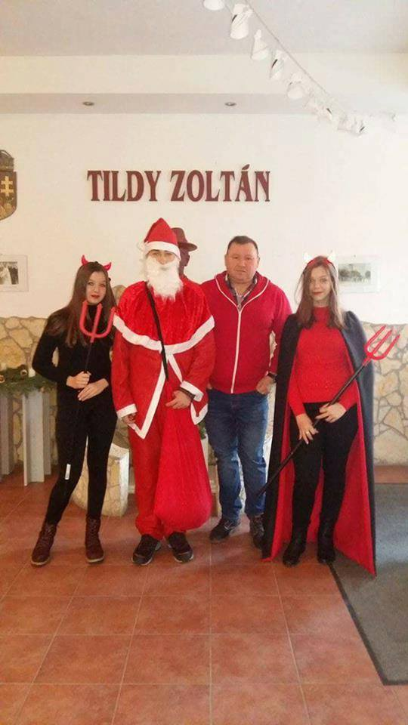
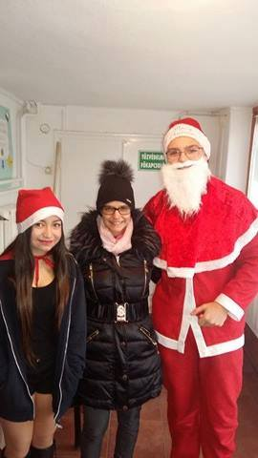
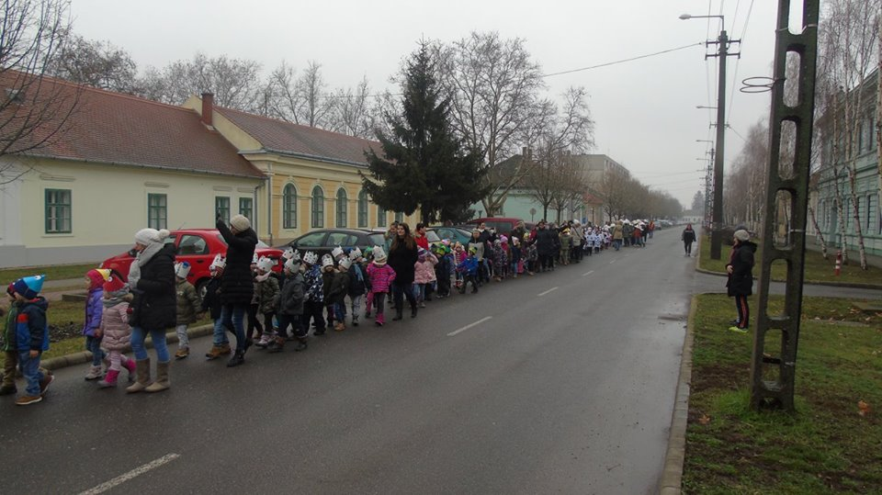
Santa Claus and Carnival
Children love this
program very much.

Slide 11
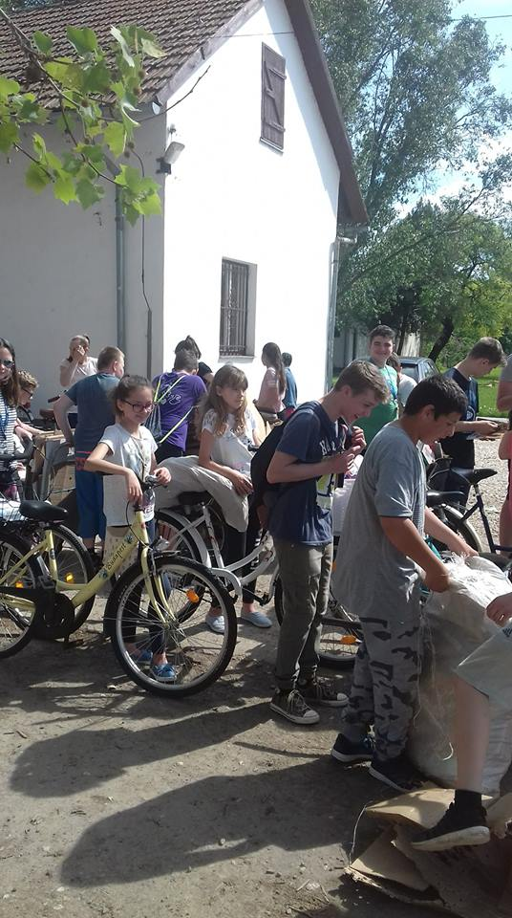
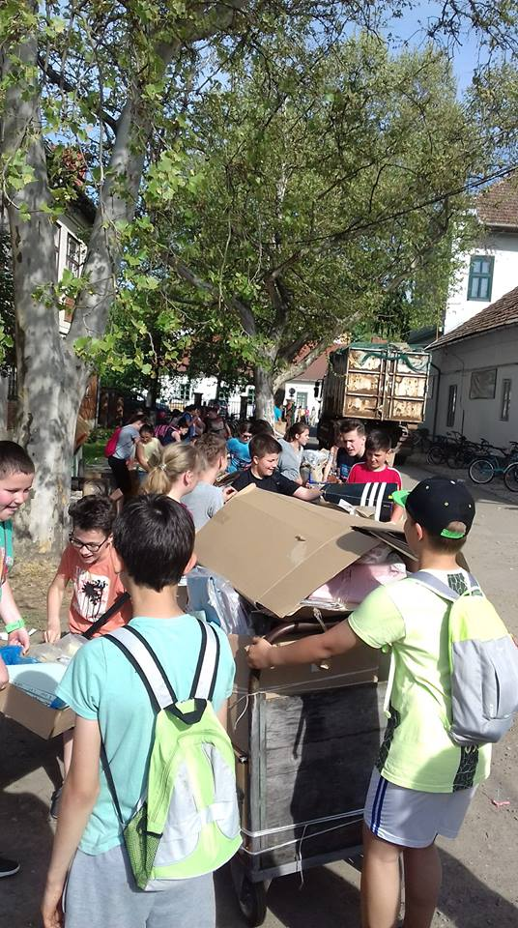
Collecting paper waste
Junior and senior pupils collect paper waste. There is a competition among the classes.

Slide 12
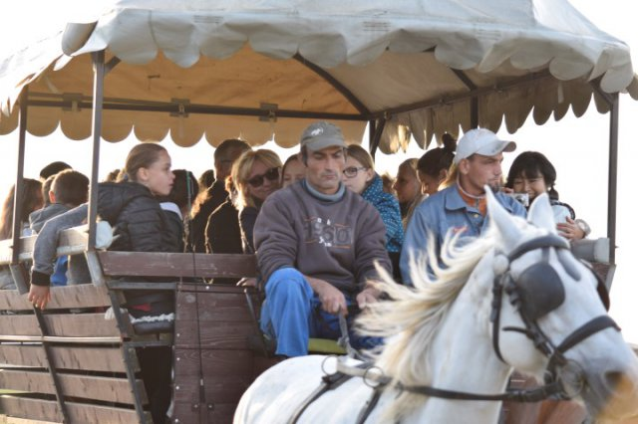
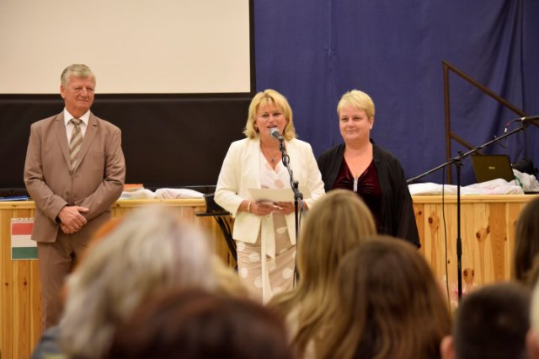
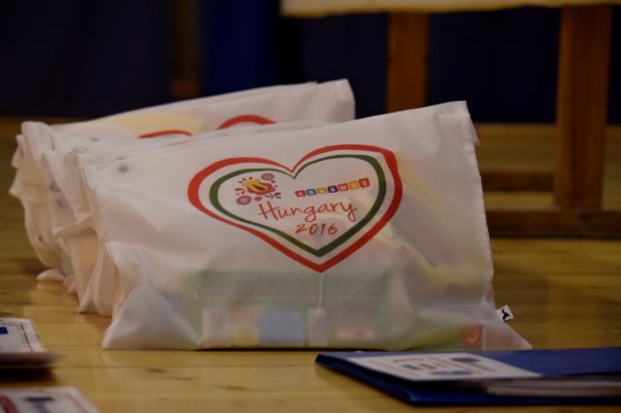
Erasmus+
It’s a really funny and exciting
program and the best way
to learn and practise English.
Zsuzsanna Koczó-Fekete
Coordinator teacher of Erasmus+ program in our school

Slide 13
Made by:
Tamás Benedek 8.a
and
Csaba Obsitos 8.b

