Slide 1
Portugal

Slide 2
Portuguese dance
The vira is a traditional dance from Portugal. It is most popular in the Minho region but is performed in every region. It has a three-step rhythm which is very similar to a waltz, but it is faster and the couples dance front-to-front without holding hands.

Slide 3
Portuguese art
Portuguese artist usually painting in romantic style. It’s from mediavel ares.
Well-know painters in romantic style:
Miguel Ângelo Lupi (1826-1883)
Luís de Meneses
But lately people are painting in street on abandoned, old walls, It’s called street art.
We do not know the makers of street art.
You also need permission from the owner of the wall before you paint on it.

Slide 4
Popular Portuguese Meals
Caldo Verde, a soup made of sausages, potatoes and local olive oil.
Bread soup, a soup flavoured with garlic, it contains bread and eggs too.
There are lots of meals connected with seafood.

Slide 5
Popular Portuguese Meals
Portuguese Cod Fish: There are a lots of ways to make it.
Sardines: It is a traditional food in portugal. It can be canned or grilled.
Bifanas: It’s a light portuguese snack. Bifanas can be served with a bowl of soup and fries for a full meal.

Slide 6
Popular Portuguese Meals
Pastéis de nata: It can be enjoyed as a “snack” with a coffee. It’s made of puff pastry, milk, flour, eggs and sugar syrup.
Queijada: If you like cheese and pastries, this dessert is perfect for you!
Rabanadas: Peoples usually eat this at Christmas. There are several ways to serve this dessert.

Slide 7
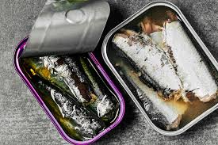
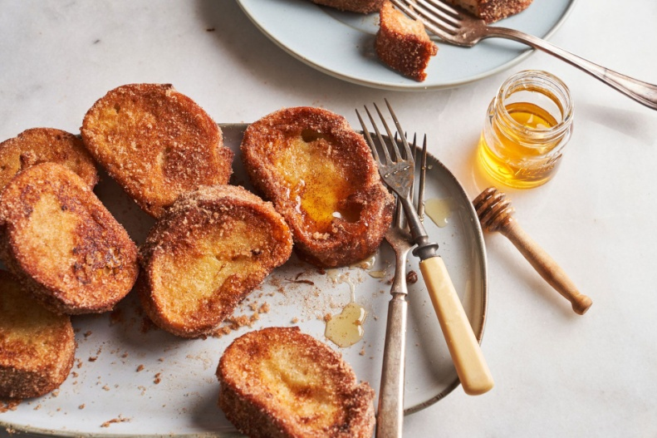
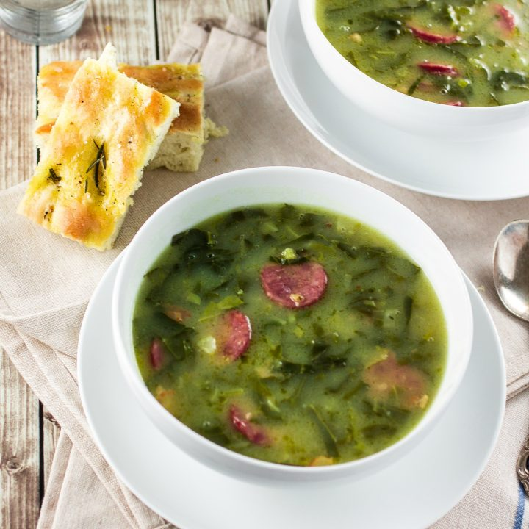
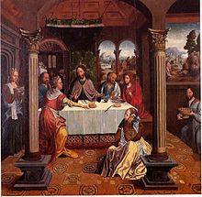
Galery

Slide 8
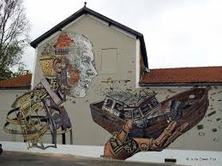
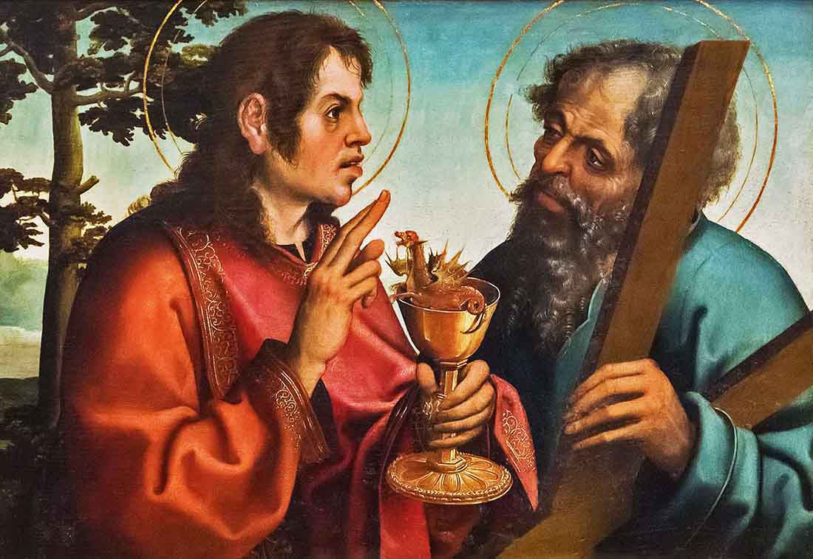
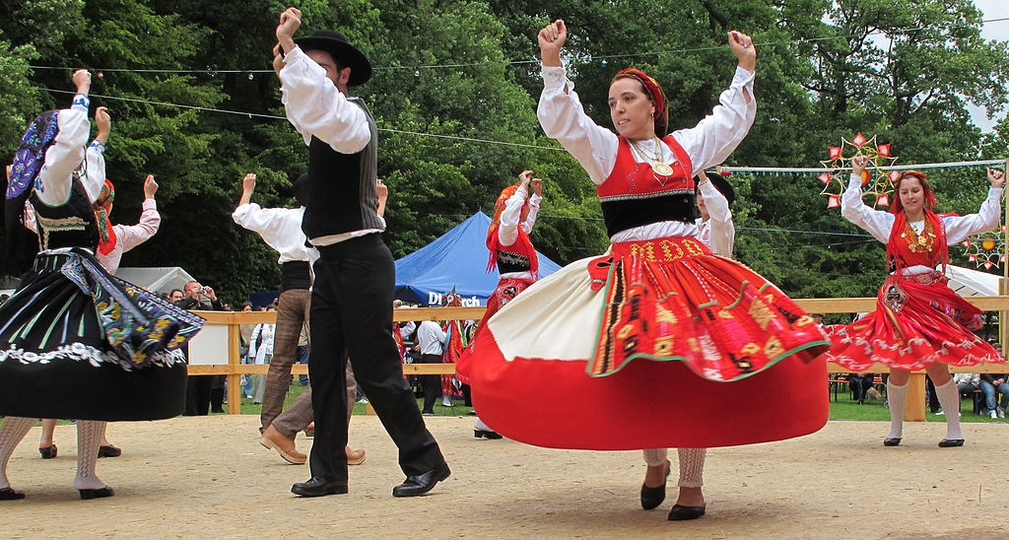
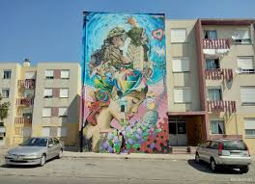
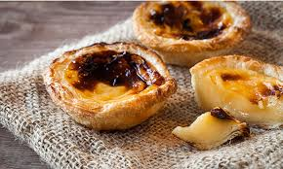
Galery

