Slide 1
PORTUGAL
ERASMUS

Slide 2
Portugal (Portuguese: officially the Portuguese Republic (Portuguese:Portuguesa is a country located mostly on the Iberian Peninsula, in southwestern Europe. It is the westernmost sovereign state of mainland Europe, being bordered to the west and south by the Atlantic Ocean and to the north and east by Spain. Its territory also includes the Atlantic archipelagos of the Azores and Madeira, both autonomous regions with their own regional governments. The official and national language

Slide 3
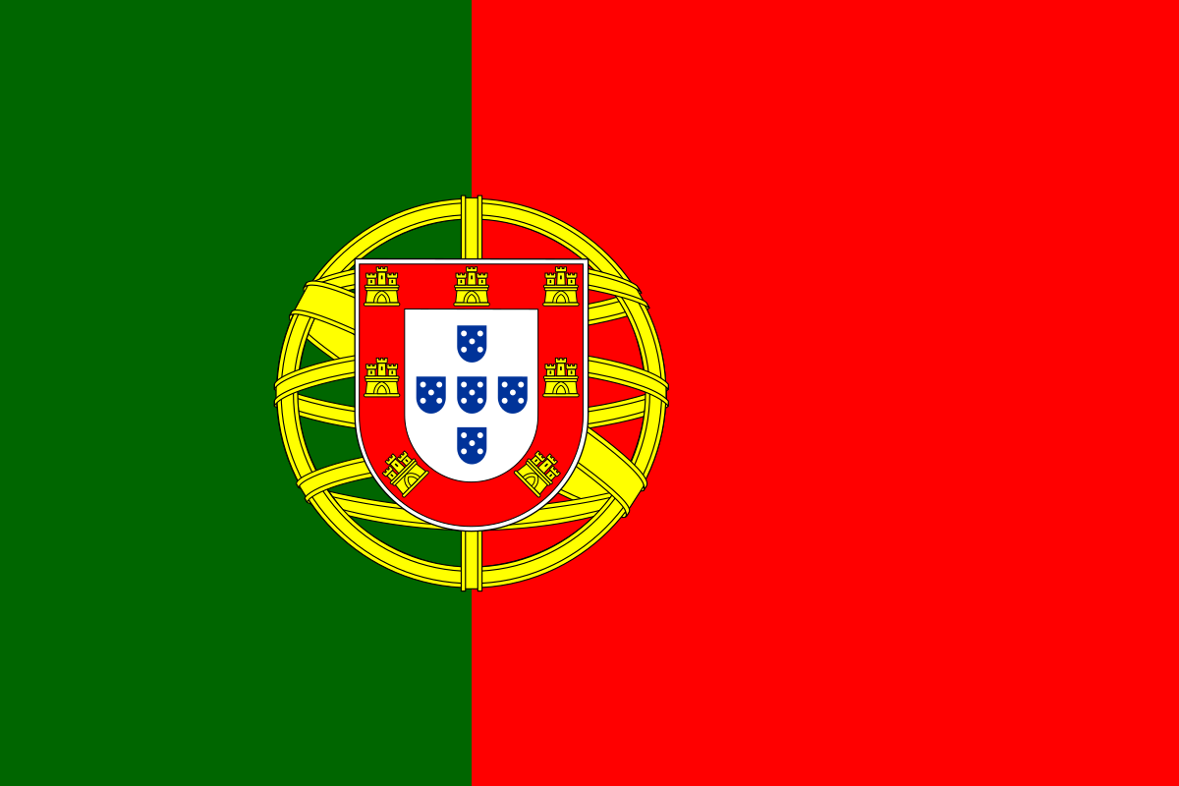
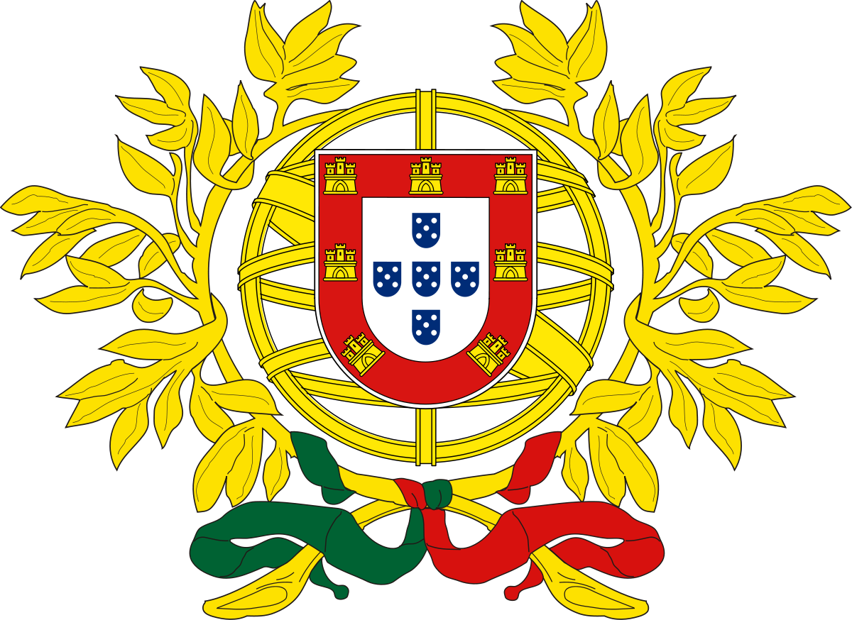
PORTUGAL FLAG

Slide 4
Portugal information

Slide 5
Laguage:portuguese
Capital:Lisbon
Population:
2019 estimate
10,295,909[

Slide 6
PORTUGAL Food:

Slide 7

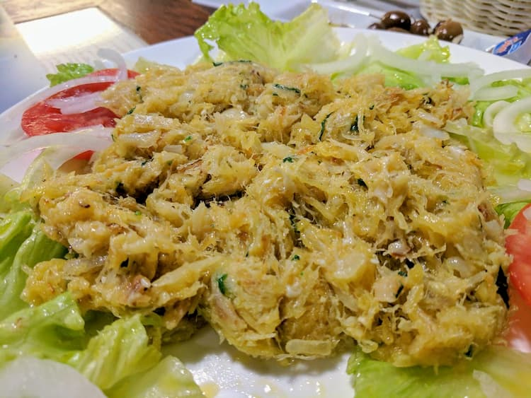
Bacakhau á brás
Bacalhau à brás
Salted cod is the darling of typical Portuguese food, and you’re sure to find more iterations of this beloved staple than you’ll manage to try. “Brás” style is among the most popular though, and with good reason.
The shredded cod is sautéed in a pan along with plenty of onions and straw fried potatoes. This dish is finished up with beaten eggs that cook as they join the pan and topped with parsley and black olives. Typical Portuguese food at its best.

Slide 8
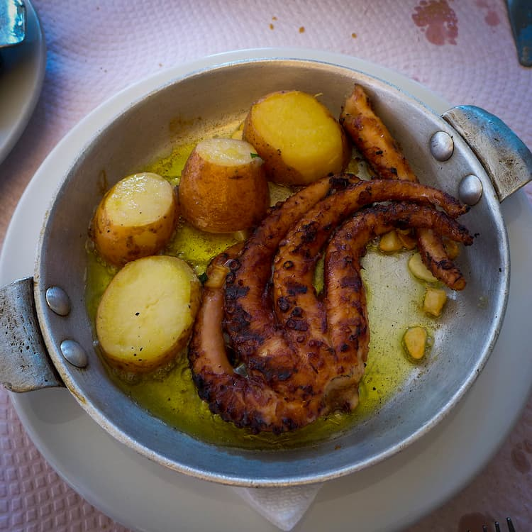
Polvo á lagareiro
If you love octopus, you’ll be glad to learn that the Portuguese have perfected the art of making it both flavourful and tender. In this dish, the octopus is first boiled then baked in the oven with potatoes. Finished with a healthy dose of olive oil, this is a real treat when it comes to typical Portuguese food.

Slide 9
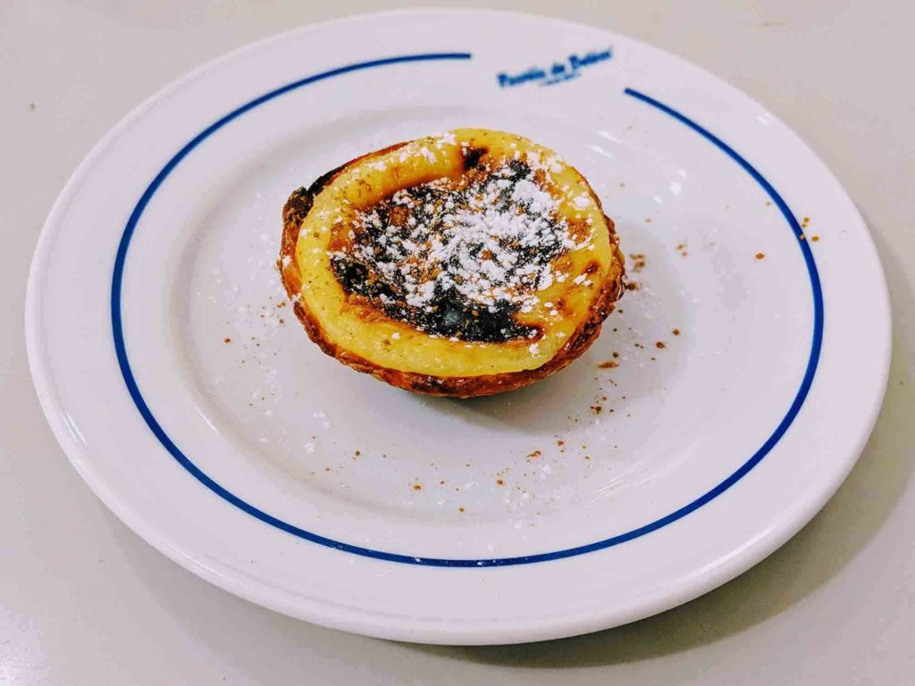
Pastel de nata
t’s probably Portugal’s most famous food, and there’s good reason for that. Pastéis de nata (or Portuguese custard tarts as they’re known outside of Portugal) are just delicious.
They originate from Lisbon, but you’ll find them in just about every café in Portugal and they’re also one of the 7 Portuguese foods that were selected to be in the “7 wonders of Portuguese gastronomy” competition.

Slide 10
Portugal famous person

Slide 11
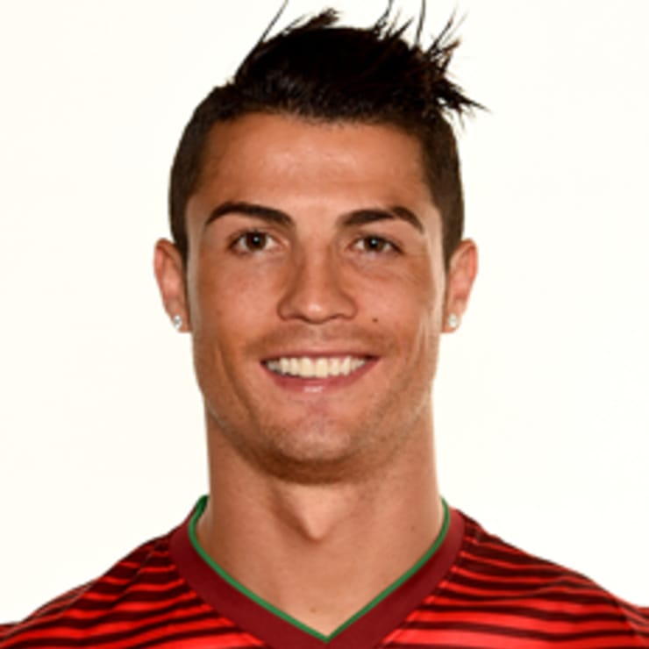
Cristiano Ronaldo
Cristiano Ronaldo dos Santos Aveiro GOIH ComM (European Portuguese: [kɾiʃˈtjɐnu ʁɔˈnaɫdu]; born 5 February 1985) is a Portuguese professional footballer who plays as a forward for Serie A club Juventus and captains the Portugal national team. Often considered the best player in the world and widely regarded as one of the greatest players of all time,^{[note 3]} Ronaldo has won five Ballons d'Or^{[note 4]} and four European Golden Shoes, both of which are records for a European player. He has won 30 major trophies in his career, including seven league titles, five UEFA Champions Leagues, one UEFA European Championship, and one UEFA Nations League title. Ronaldo holds the records for the most goals (130) and assists (40) in the history of the UEFA Champions League.^{[11]} He is one of the few recorded players to have made over 1,000 professional career appearances and has scored over 700 senior career goals for club and country.^{[12]} He is also the second player to score 100 international goals, and the first European to achieve the feat.^{[13]}

Slide 12
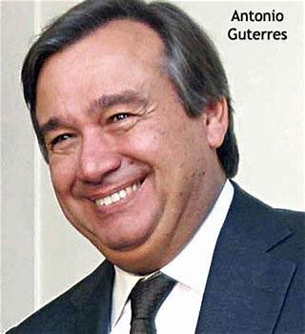
Antonio Guterres
António Manuel de Oliveira Guterres GCC GCL (/ɡʊˈtɛrəs/; European Portuguese: [ɐ̃ˈtɔnju ɡuˈtɛʁɨʃ]; born 30 April 1949) is a Portuguese politician and diplomat serving as the ninth secretary-general of the United Nations. A member of the Portuguese Socialist Party, he served as prime minister of Portugal from 1995 to 2002.
Guterres served as secretary-general of the Socialist Party from 1992 to 2002. He was elected prime minister of Portugal in 1995 and resigned in 2002 after the Socialist Party was defeated in the 2001 Portuguese local elections. After six years governing without an absolute majority and with a bad economy, the Socialist

Slide 13
A portugal map

Slide 14
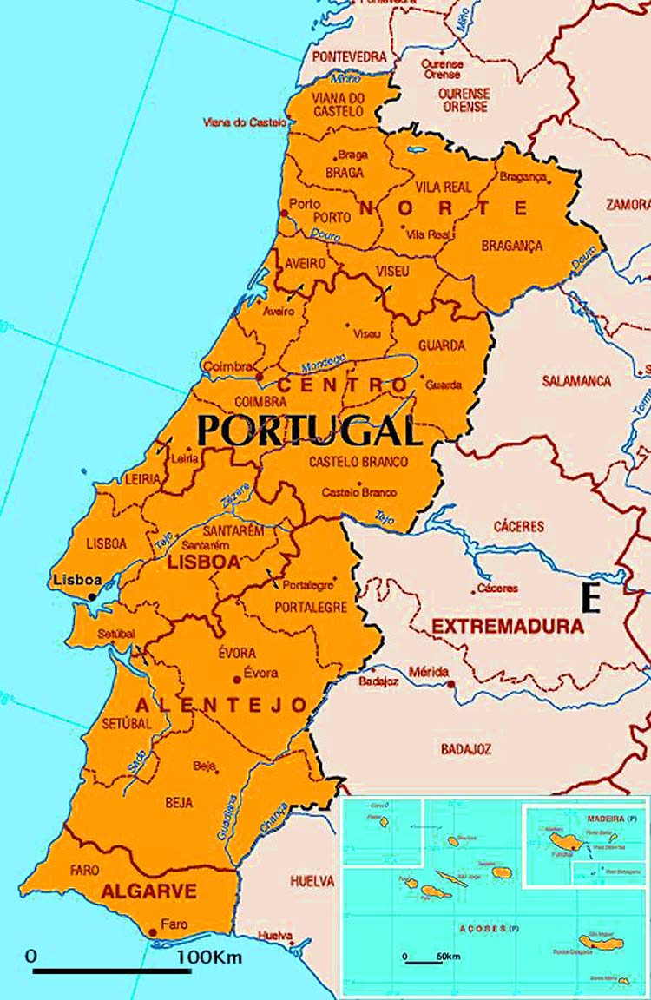
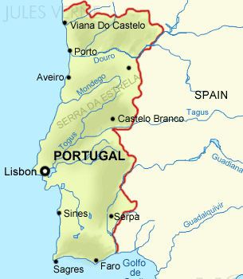
Portugal Map

Slide 15
Braga

Slide 16
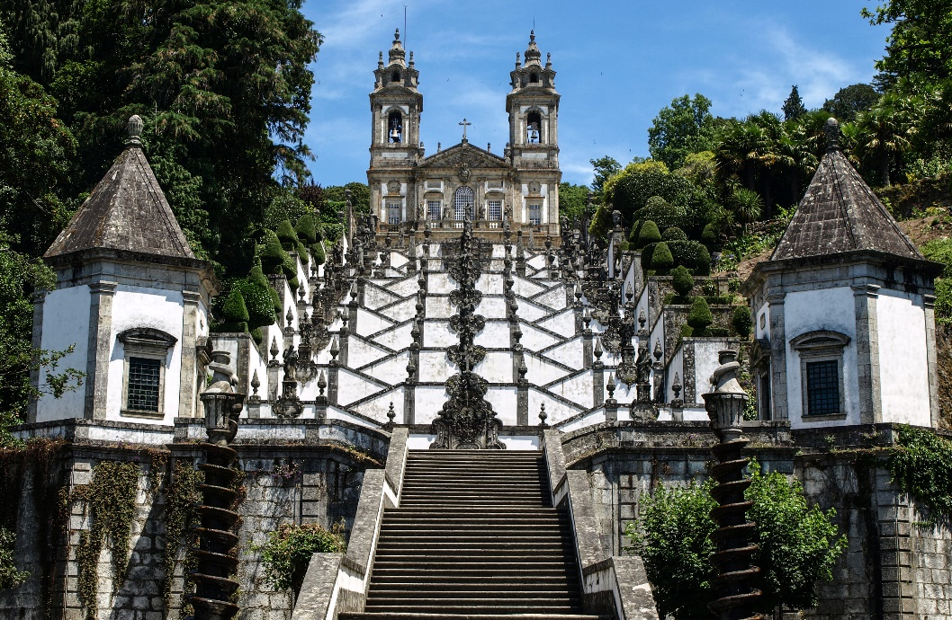
Braga’s photo’s:Bom Jesus De
Many hilltops in Portugal and other parts of Europe have been sites of religious devotion since antiquity, and it is possible that the Bom Jesus hill was one of these. However, the first indication of a chapel over the hill dates from 1373. This chapel - dedicated to the Holy Cross - was rebuilt in the 15th and 16th centuries. In 1629 a pilgrimage church was built dedicated to the Bom Jesus (Good Jesus), with six chapels dedicated to the Passion of Christ.

Slide 17
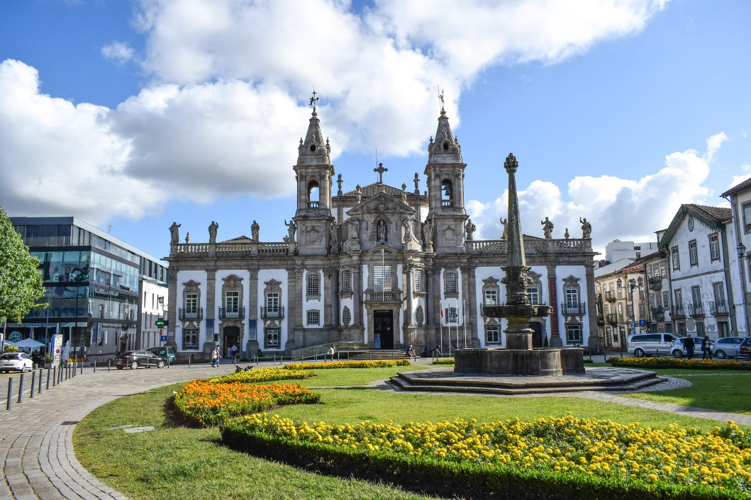
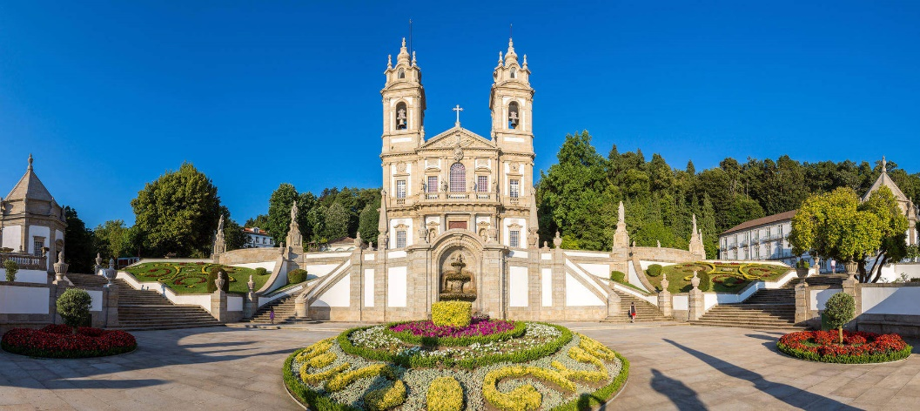

Slide 18
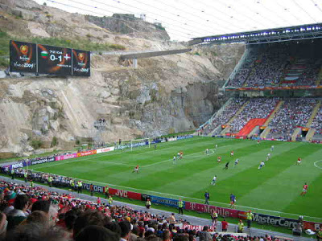
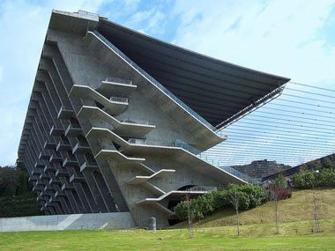
Braga stadion

Slide 19
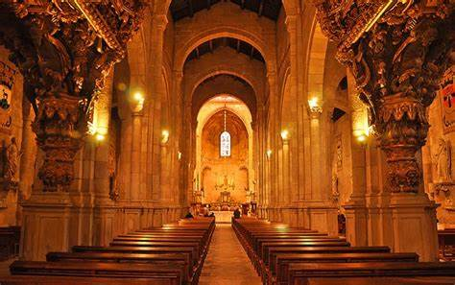
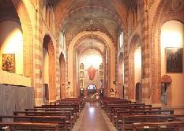
Braga’ catedral

Slide 20
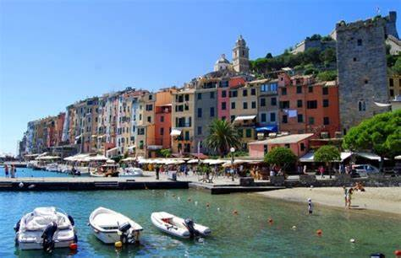
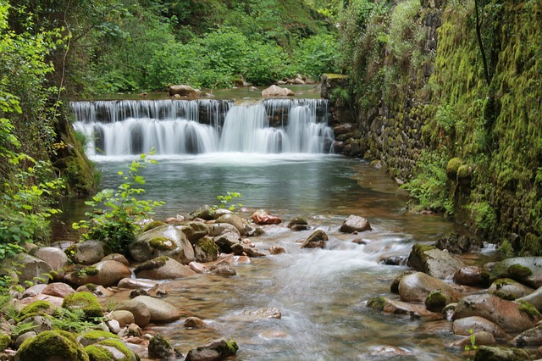
Braga is the source of miracles

Slide 21
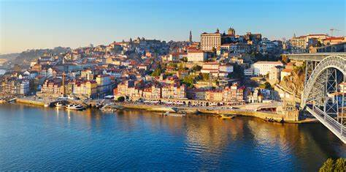
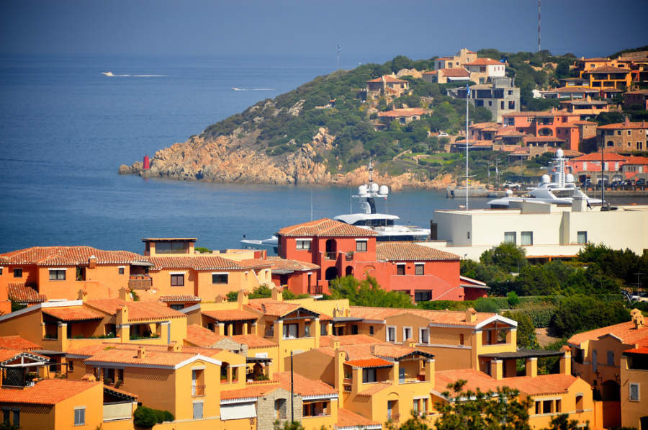
PORTO
Porto’s a very big city

Slide 22
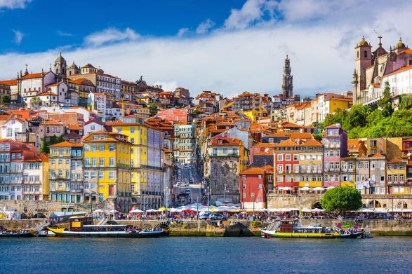
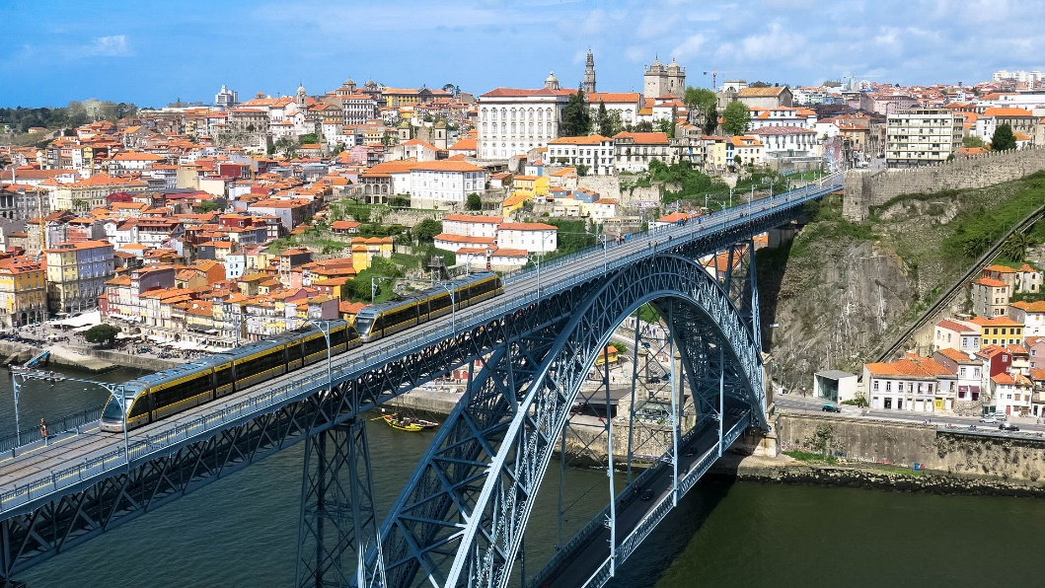
Porto
Porto is a storehouse of beauties

