Slide 1
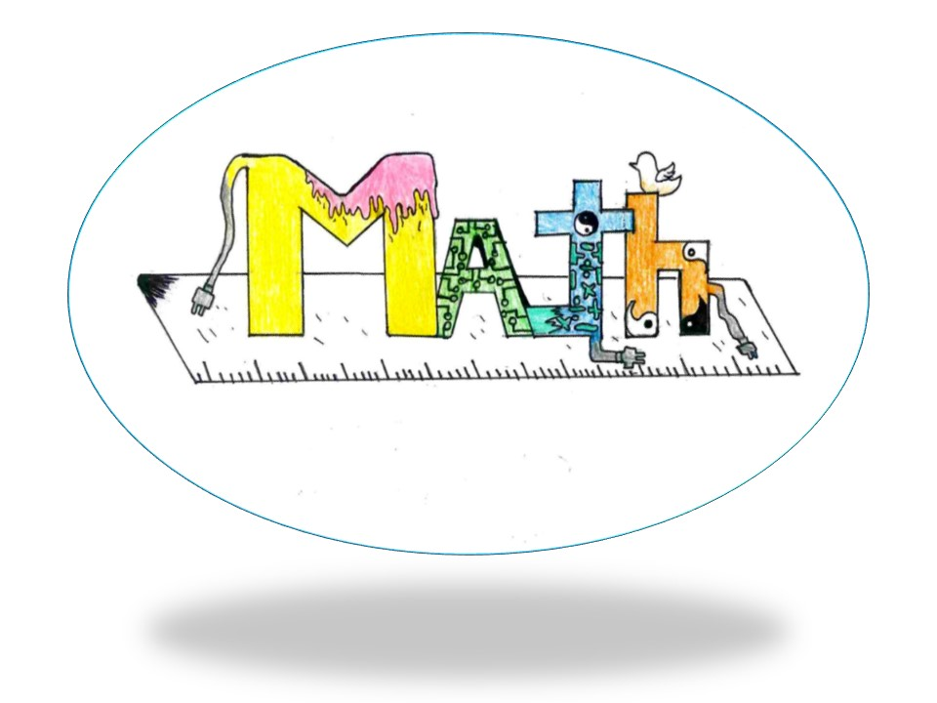
MATH (Math, Art and Technology in Harmony)
LTTA in Portugal
Erasmus+ Project
01/03/2020 – 07/03/2020

Slide 2
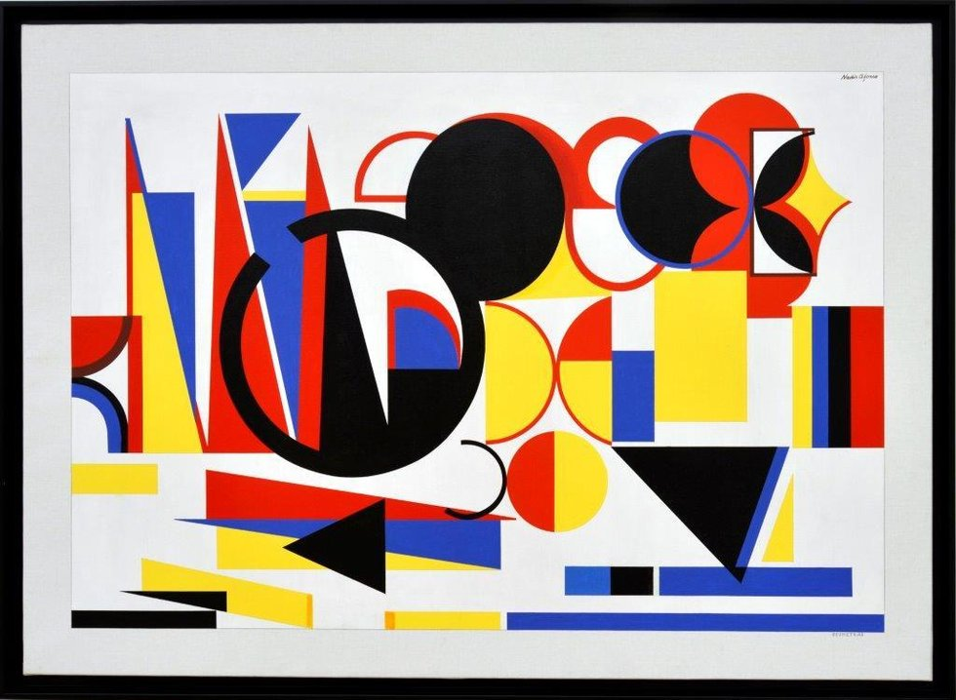
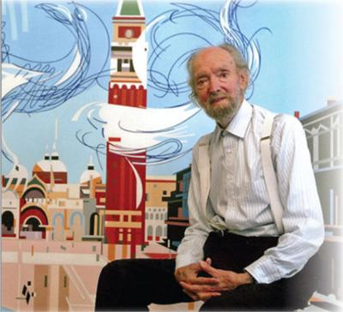
Nadir Afonso
Portuguese Artist

Slide 3
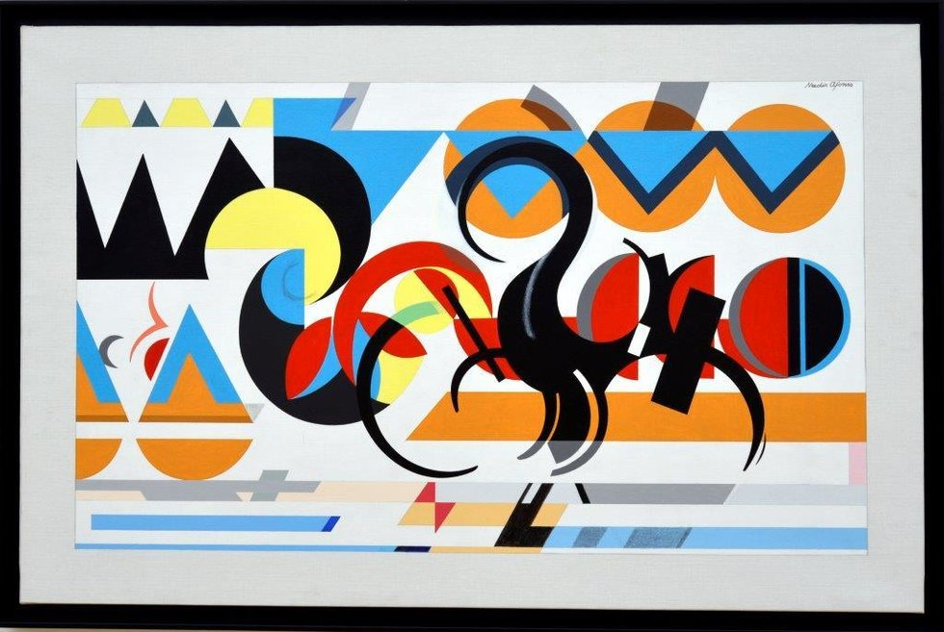
Nadir Afonso
Date of birth: 4th dezember 1920, Chaves
Date of death: 11th dezember 2013, Cascais
Nationality: Portuguese

Slide 4
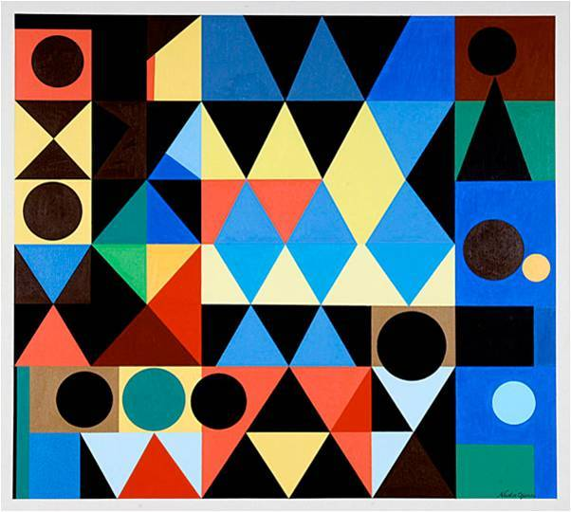
Nadir Afonso

Slide 5
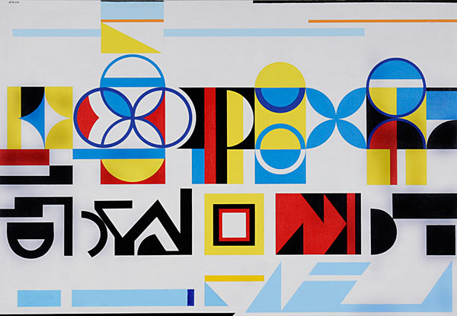
Nadir Afonso

Slide 6
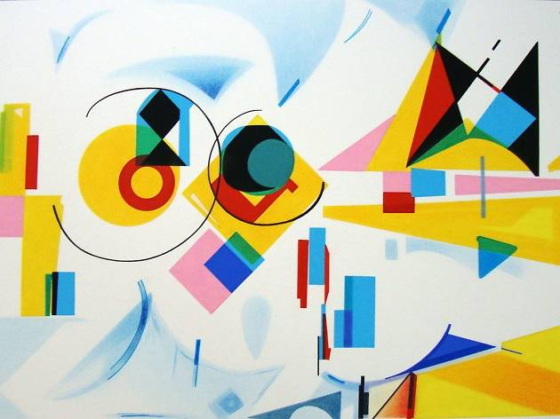
Nadir Afonso

Slide 7
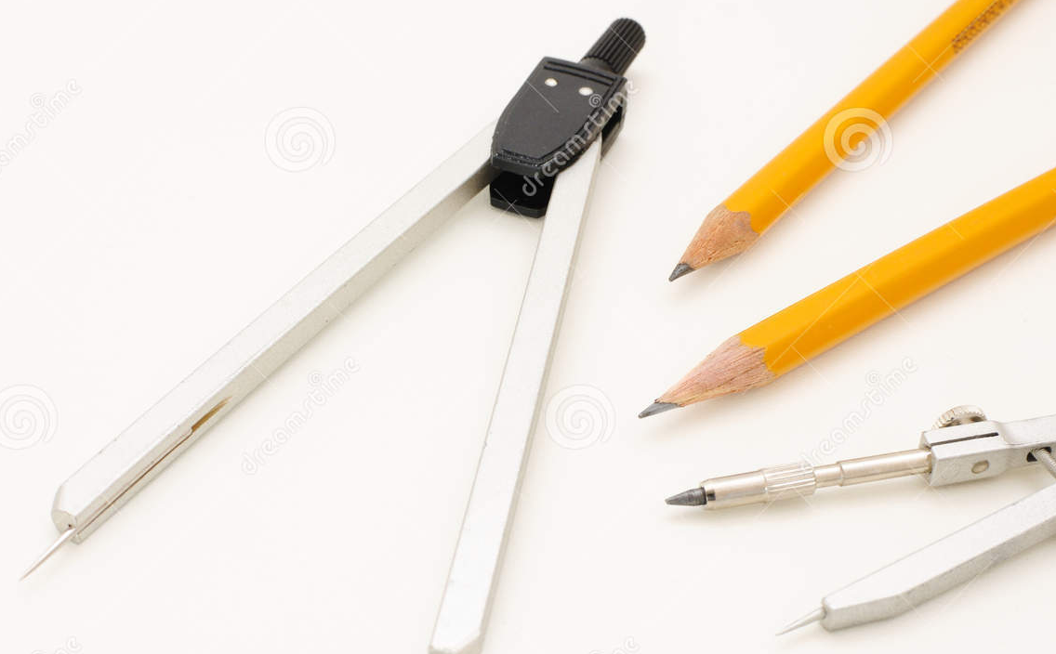
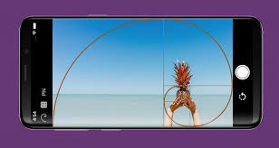
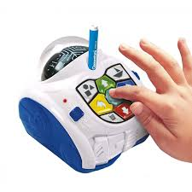
Let’s create our paintings
using Mind designer robot, drawing materials and
golden ratio proportion
50 cm x 30 cm

Slide 8
Golden ration, examples:

Slide 9
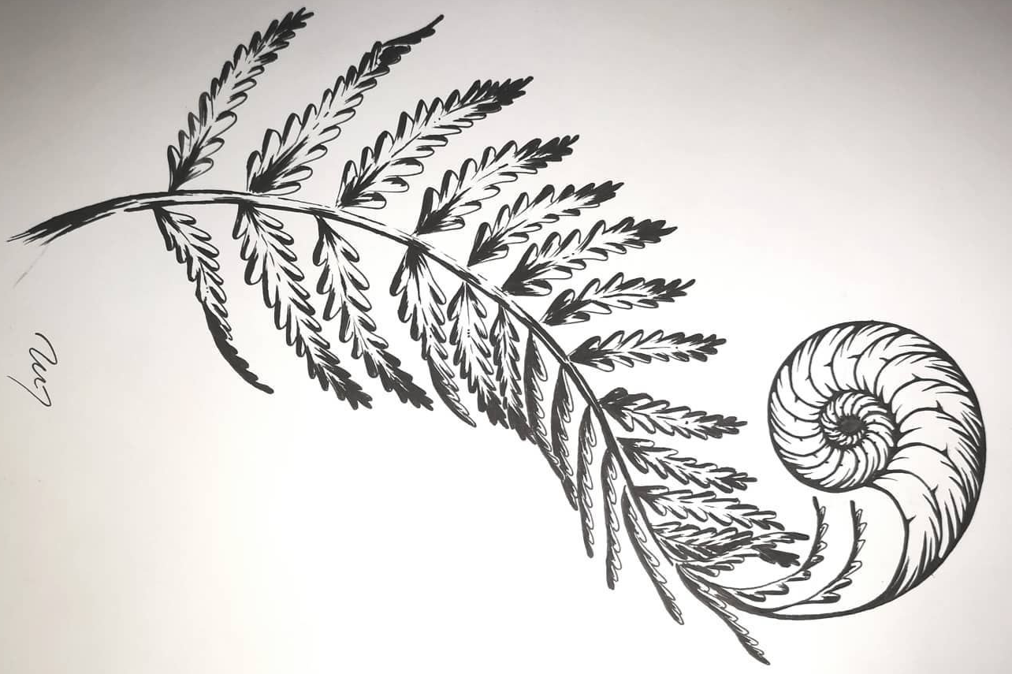
Golden ration, examples:

Slide 10
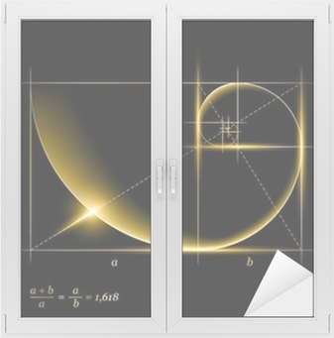
Golden ration, examples:

Slide 11
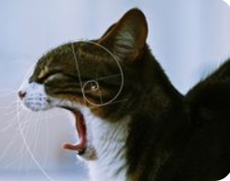
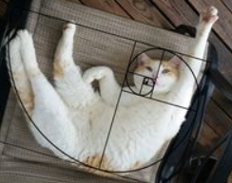
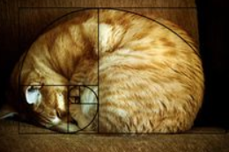
Golden ratio proportion, examples:

Slide 12
Nadir Afonso

