Slide 1
Journey to Portugal

Slide 2
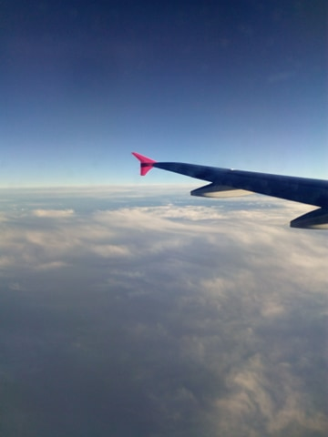
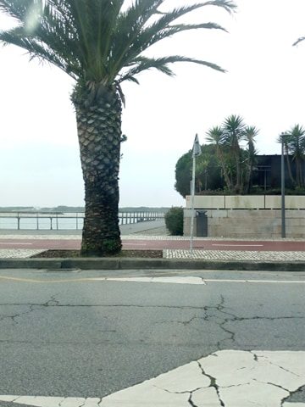
I travelled by air to Portugal with Erasmus+ programme on 29 February.

Slide 3
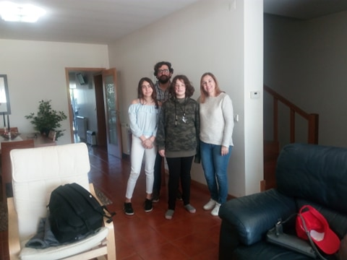
We were accomodated at the house of a kind portugal family.

Slide 4
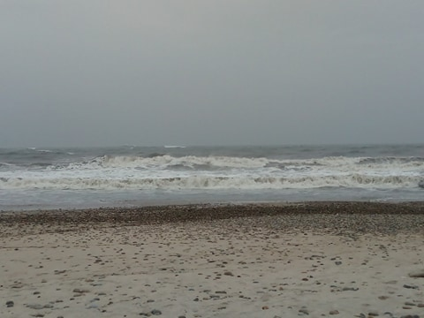
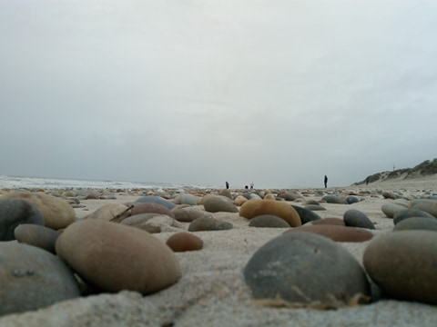
It was the first time I have ever seen the ocean. It was magnificient.

Slide 5
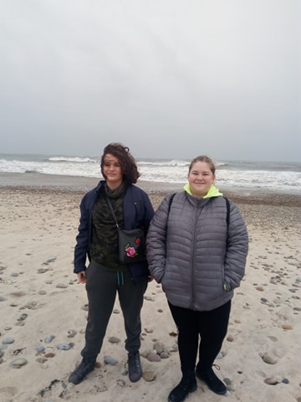
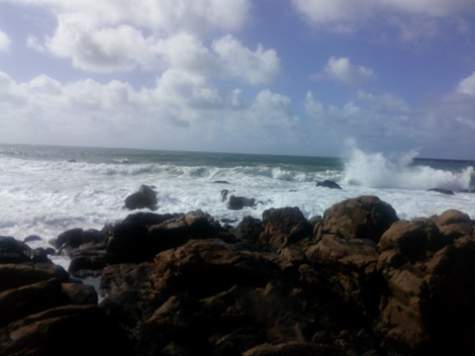

Slide 6
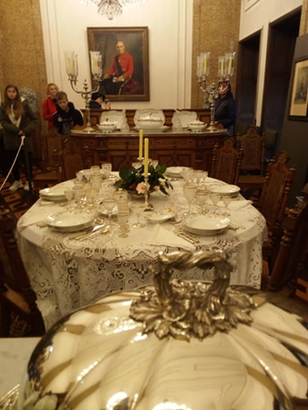
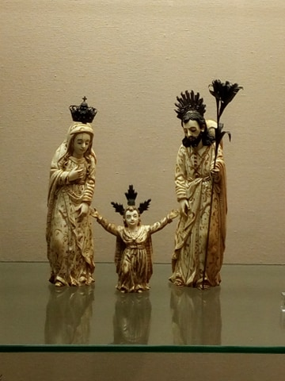
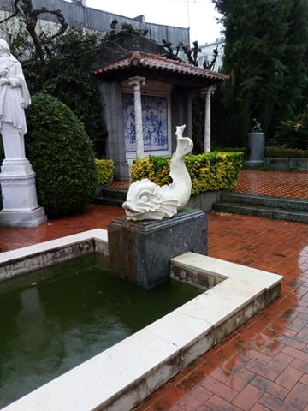
We visited Braga, and saw a very interesting and beautiful museum..

Slide 7
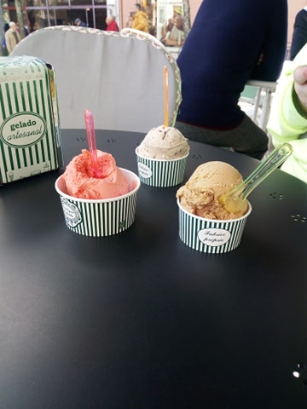
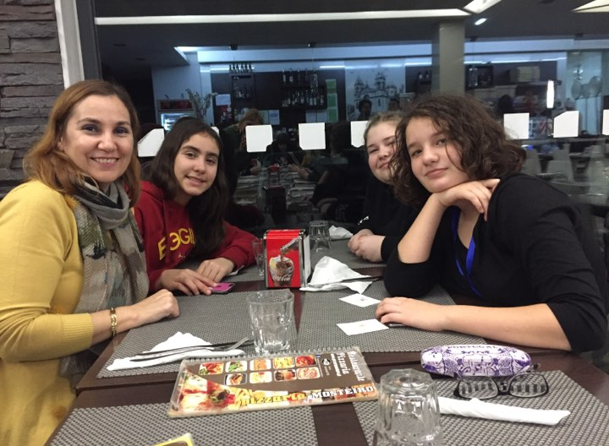
We ate lots of delicious food.

Slide 8
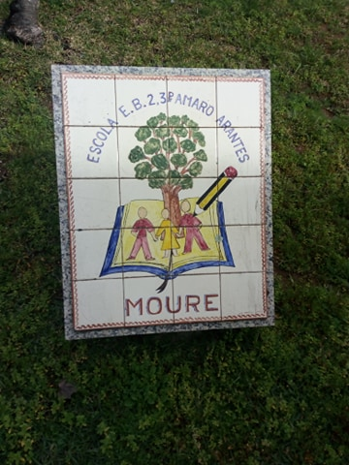
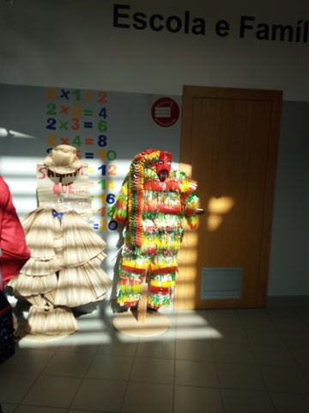
We spent a lot of time in their school.

Slide 9
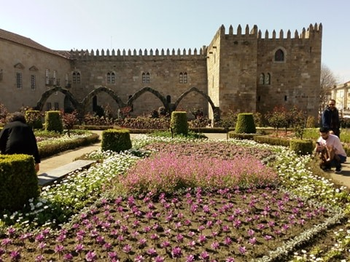
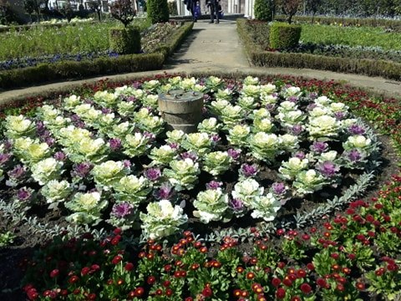
Last day we went to Braga, where we had a good time, we saw lots of beautiful places.

Slide 10
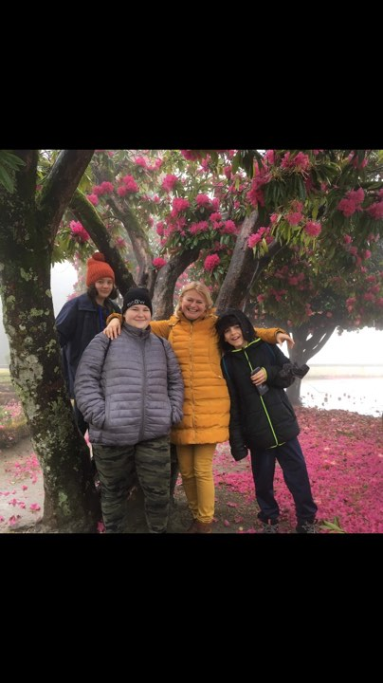
Thank you!
I had a really good time. The host family was very funny. We always played cards or computer games with Joana or we went to a cafe with their friends. Portugese people are very friendly and funny and hospitable.

