Slide 1
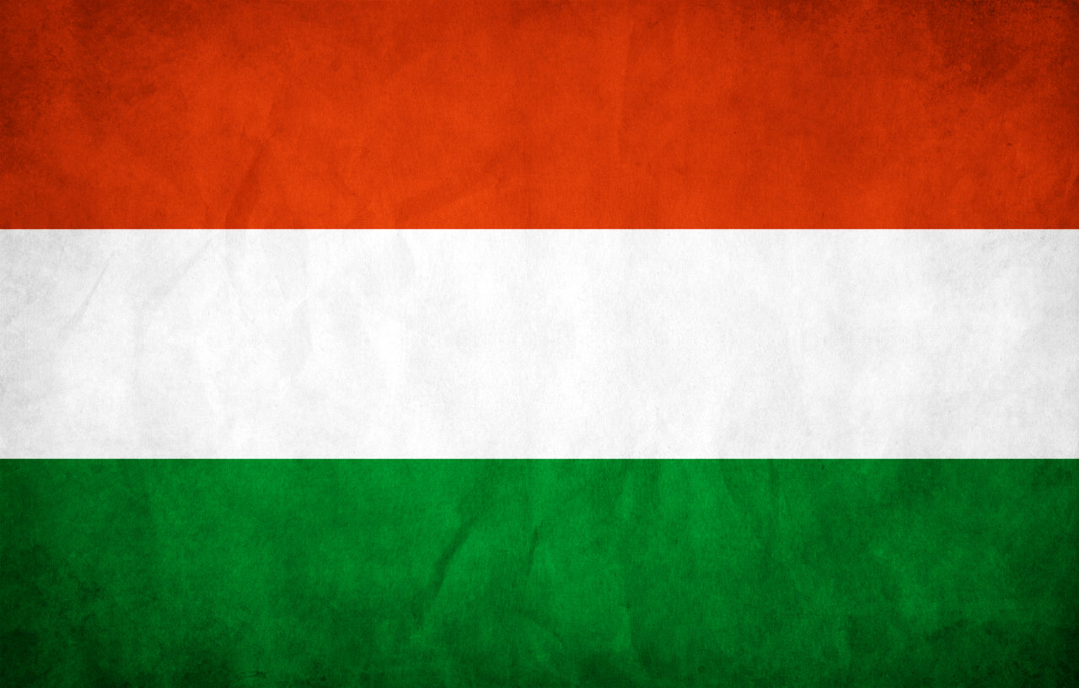
HUNGARY

Slide 2
The Hungarian flag has got 3 parts: red, white and green. They have important meanings:
Power
Truth
Hope

Slide 3
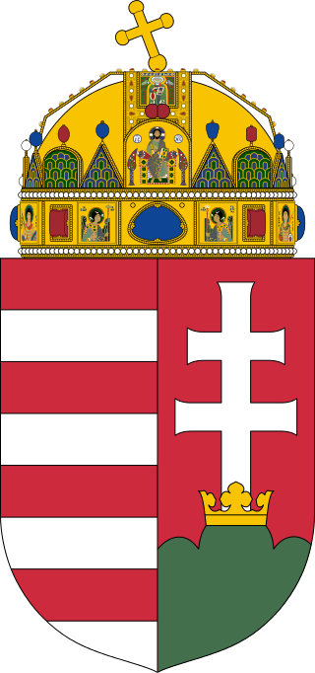
coat-of-arms
Holy Crown
Árpád stripes
Double Cross
Three pile

Slide 4
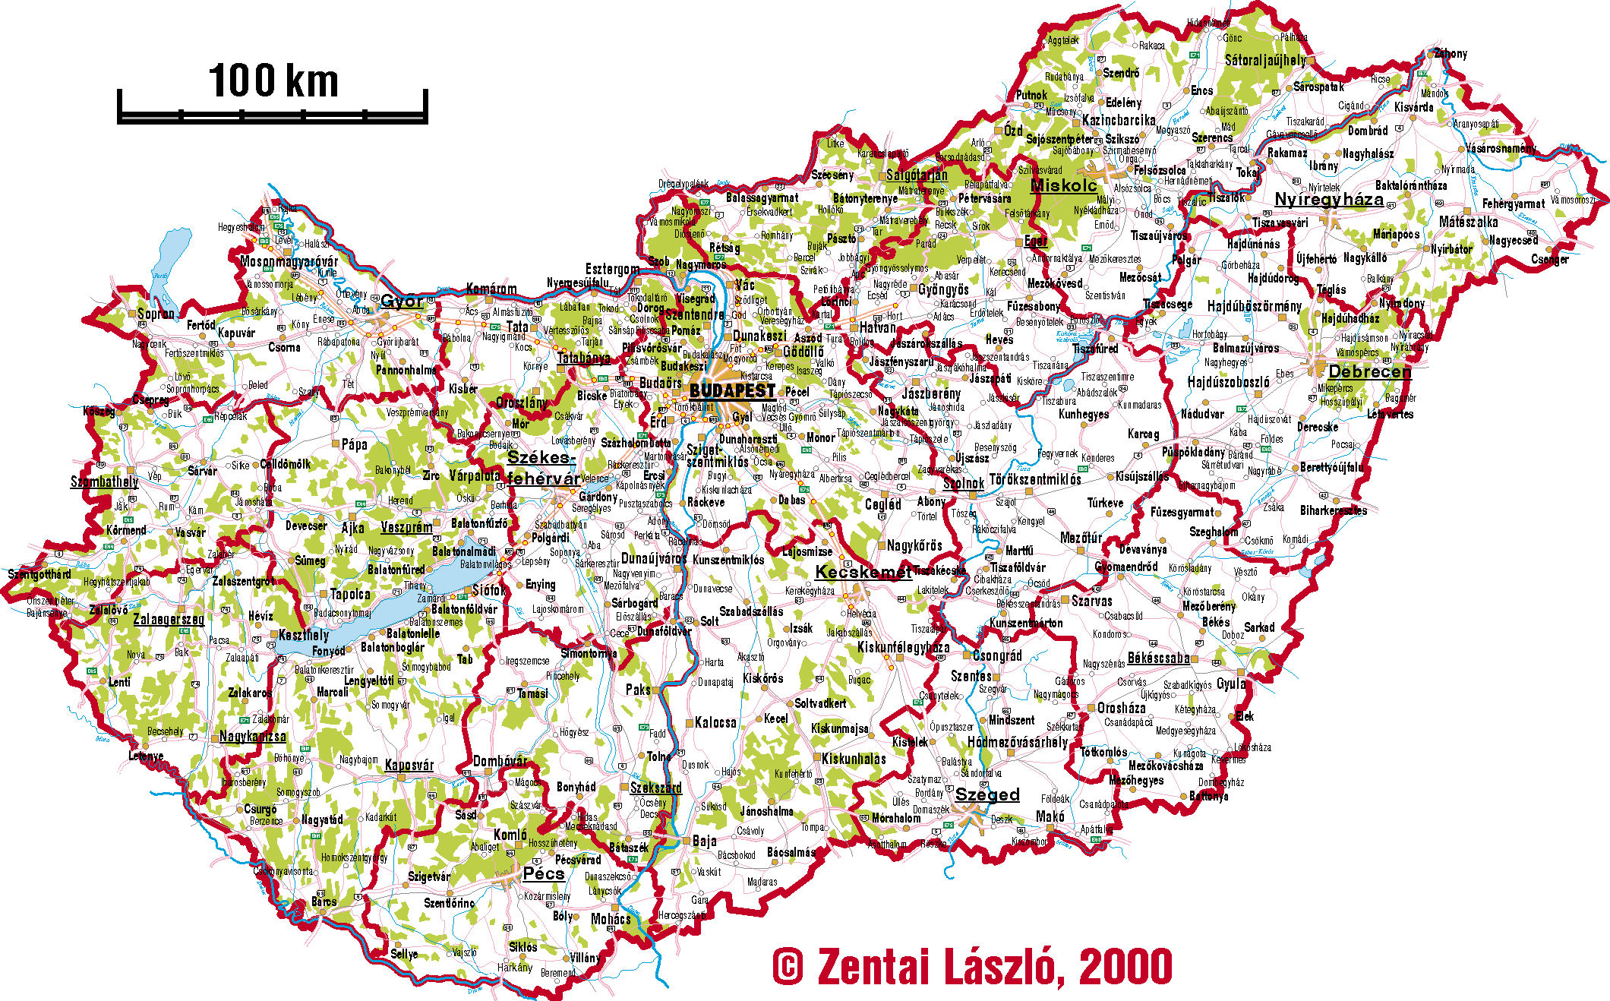
The area: 93 030 km²
Population: 9,797,561
Official language: Hungarian
Capital: Budapest
Number of counties:19
Prime Minister: Viktor Orbán

Slide 5
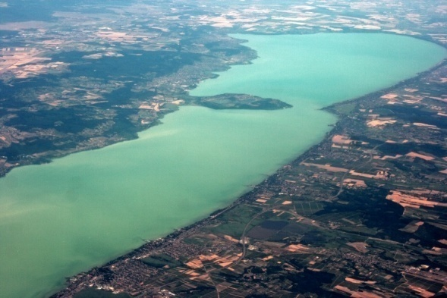
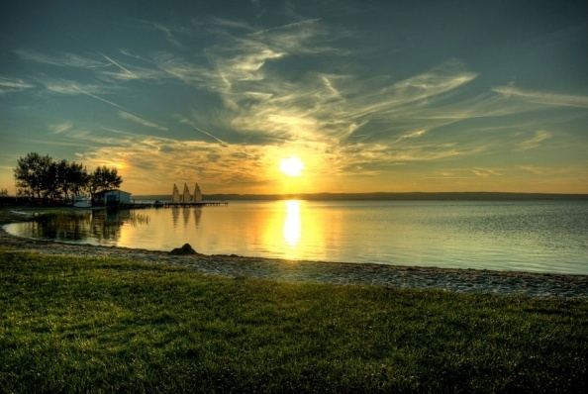
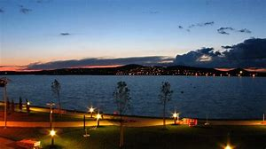
Hungary has got three big lakes
Balaton
Fertő lake
Velence lake

Slide 6
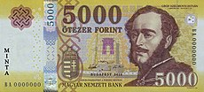
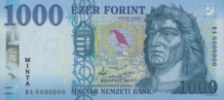
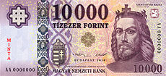
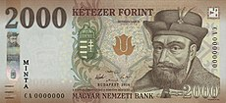
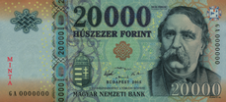
Hungary’s currency is called forint
500 Ft
5000 Ft
1000Ft
10000 Ft
2000 Ft
20000 Ft

Slide 7
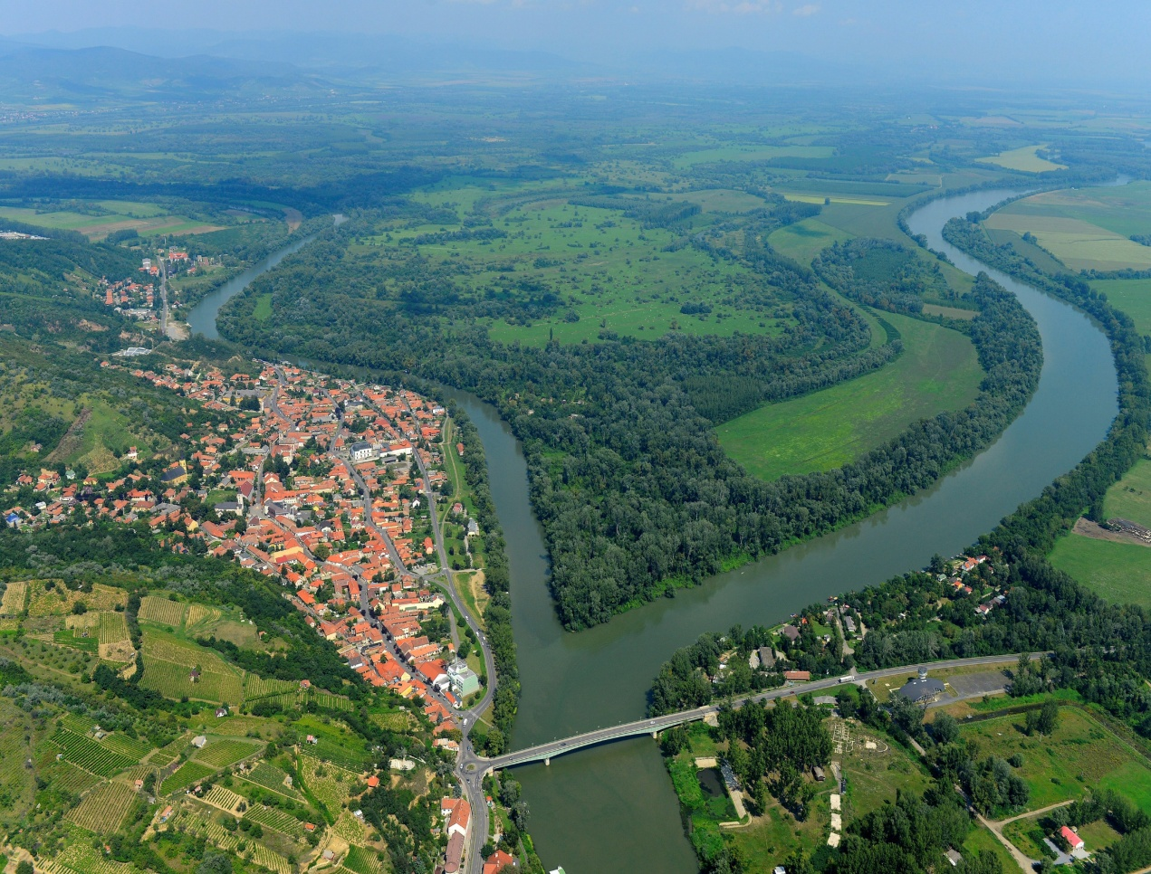
Duna Two main rivers Tisza

Slide 8
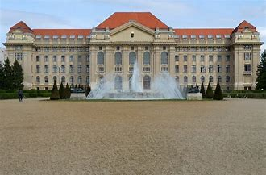
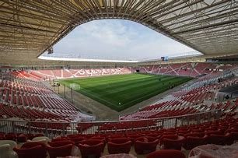
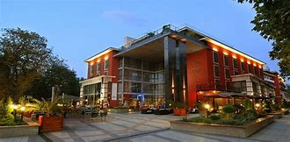
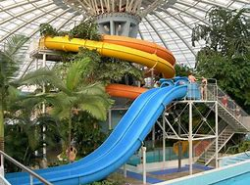
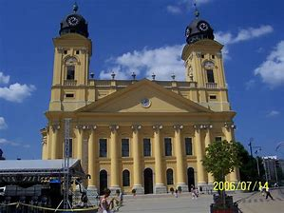
Debrecen is the second largest city in Hungary

Slide 9
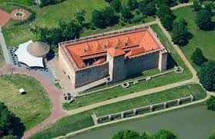
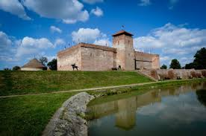
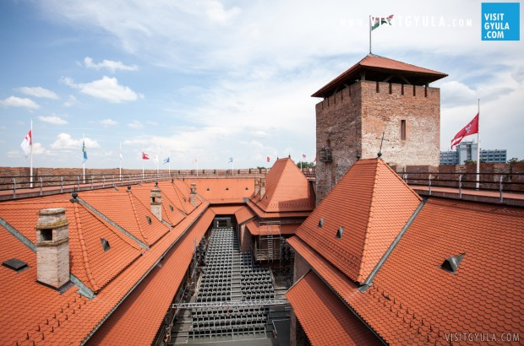
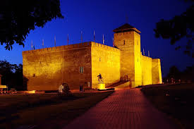
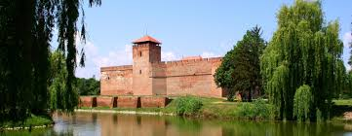
This is the Castle in the city of Gyula

Slide 10
About the castle
Built in the fifteenth century, it is the only intact remaining brick castle from the towns of the Hungarian Plains. The start of its construction is linked to the name of the nobleman János Maróti Macso and its completion to the János Corvin's name. To János Corvin’s name is also linked the construction of the Bastion, which is located near the Kerecseny gate. After the assault from 1566 the town was under Ottoman influence for 129 years, until 1695 resulting in the expulsion of the Turks out of the country.

Slide 11
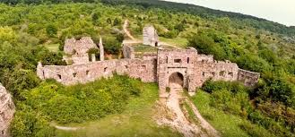
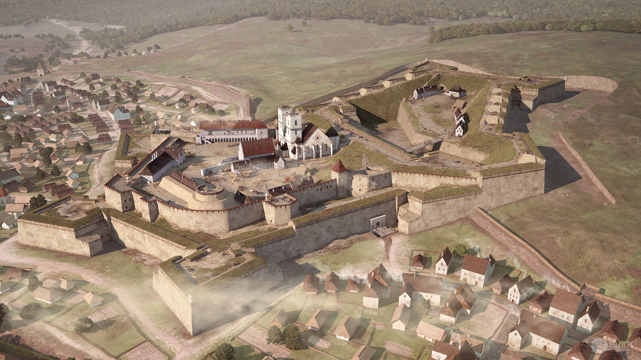
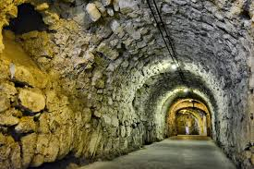
This is the Castle in th city of Eger

Slide 12
In the 16th century the Castle of Eger was an important stronghold in the fortress system of the Hungarian Kingdom, which was divided into three portions because of Ottoman occupation, and served as the “shield of Europe”. The most famous event in its thousand years long history was the siege of 1552, when the two thousand men strong defending force led by István Dobó managed to repel a Turkish army nearly thirty times larger. The contemporary cronicler, Sebestyén Tinódi Lantos, was the first to commemorate the victory in his historical songs, which became a central part of our national heritage through many additional works of literatura and the fine arts. The role of the defenders of Eger in Hungarian hero-worship culture was further strengthened by the highly popular novel written by Géza Gárdonyi, entitled the “Eclipse of the Crescent Moon” and also by the films based on it.

Slide 13
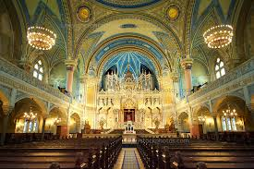
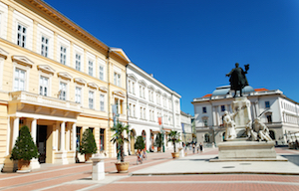
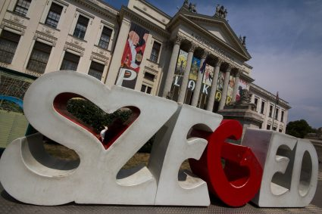
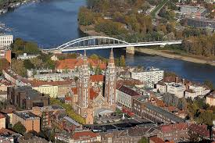
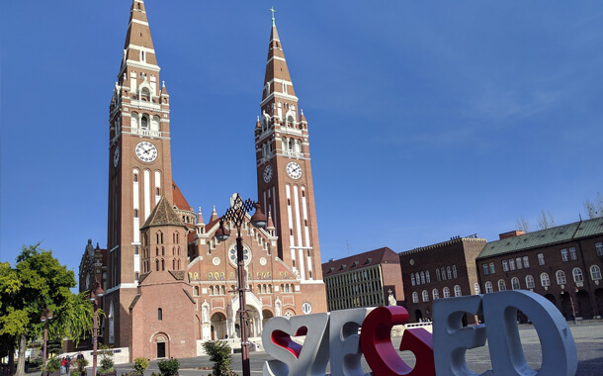
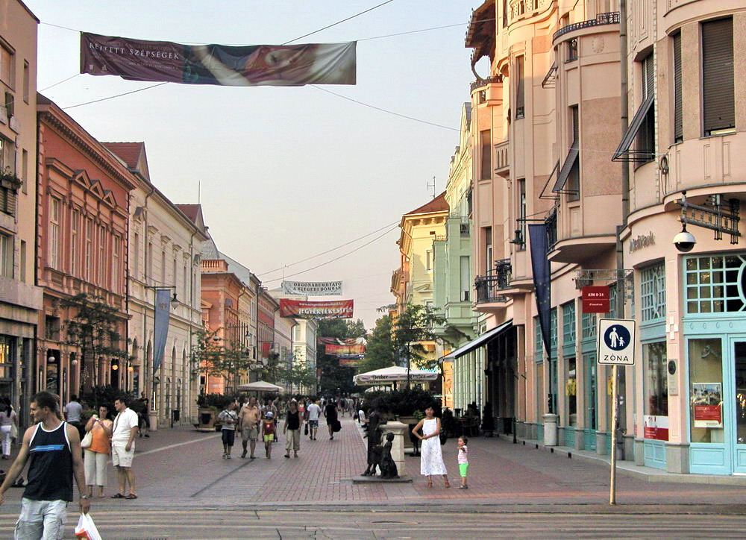
Szeged, the city of sunshine

Slide 14
23 Million years ago a volcanic eruption buried an entire subtropical jungle under volcanic ash and created a prehistoric site near Salgotarjan in the North of Hungary. This resulted in one of the world's richest fossil records of petrified plants, footprints and animal bones plus teeth of aquatic animals. Amongst the exhibits are the teeth of 24 different species of sharks as well as the teeth of crocodiles and dolphins, an almost 100 m tall petrified pine, more than 15,000 subtropical, exotic leaves and 3,000 animal footprints of 11 species.
The fossils can be viewed thanks to a preservation order established in 1944 and the site is now managed by the Directorate of the Bükk National Park. In 2010the Site became the main gateway to the world's second transborder geopark, the Novohrad-Nógrád Geopark.

Slide 15
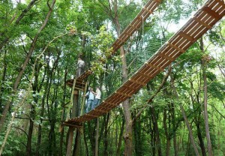
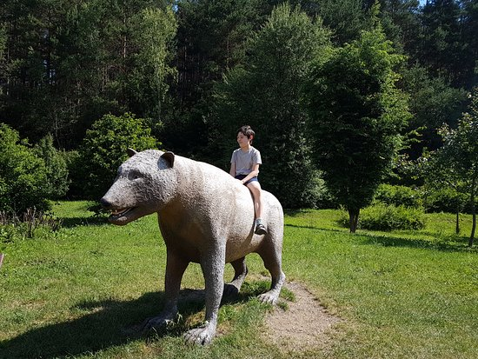
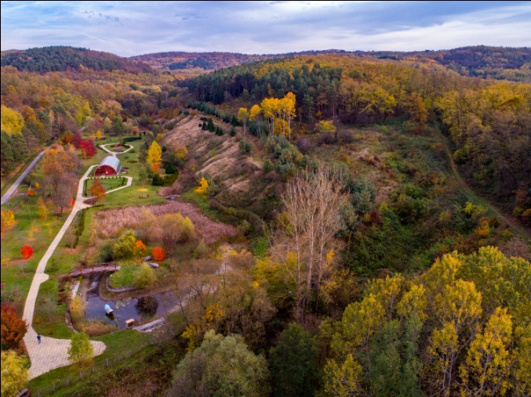
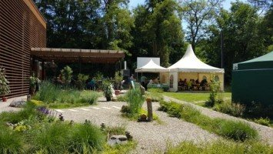
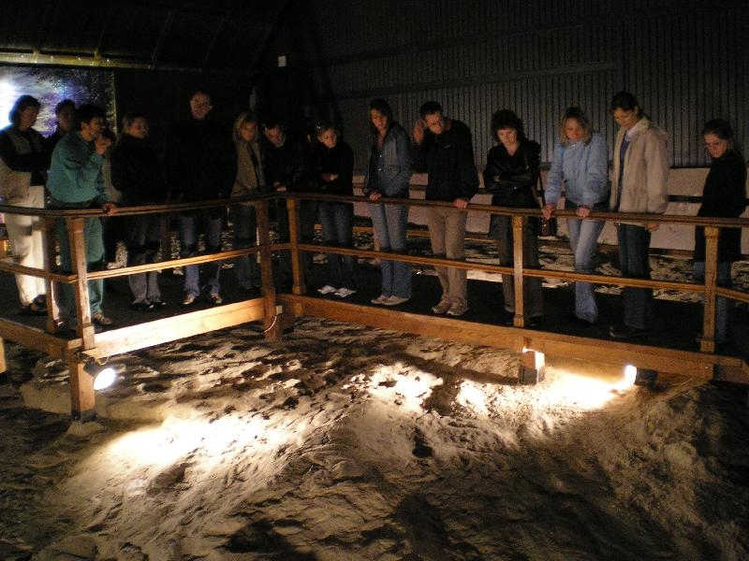
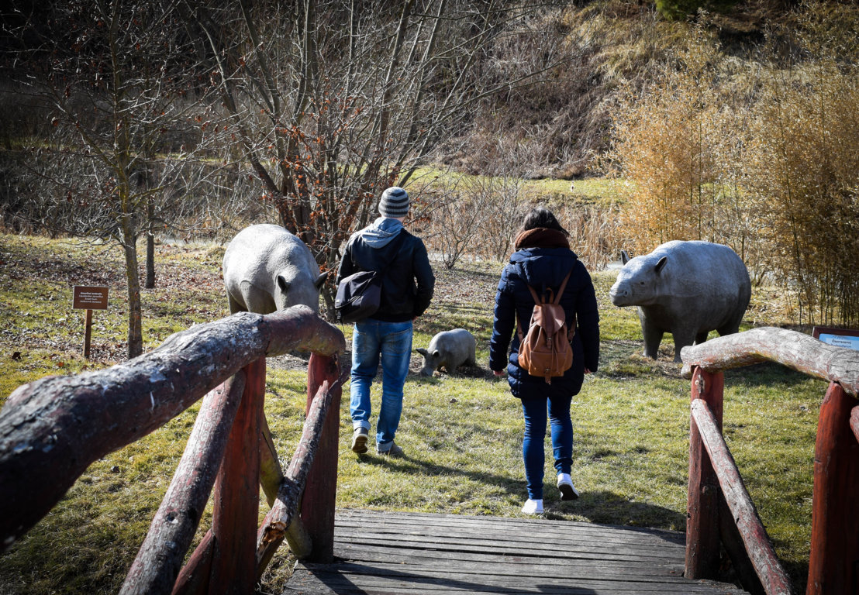
Ipolytarnóc ancestral park

Slide 16
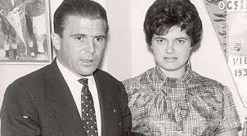
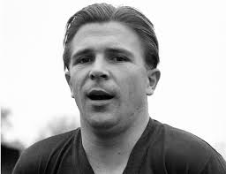
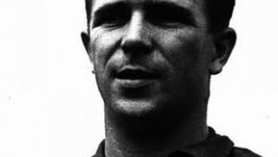
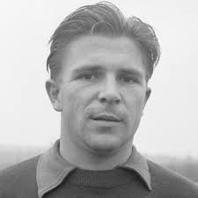
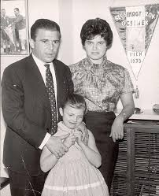
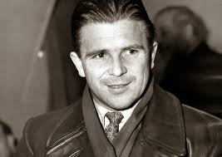
Ferenc Puskás is our famous Hungarian football player

Slide 17
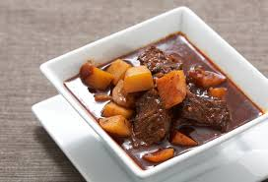
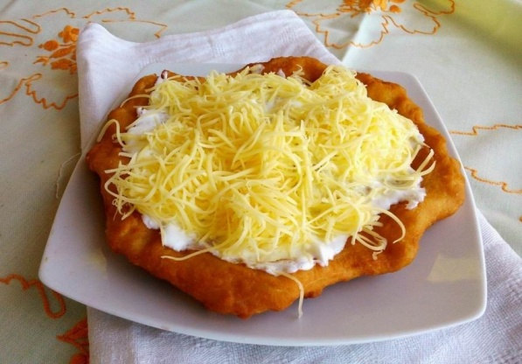
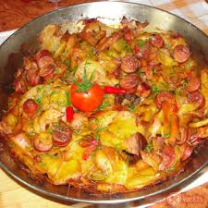
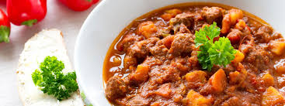
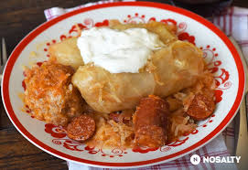
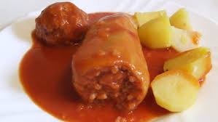
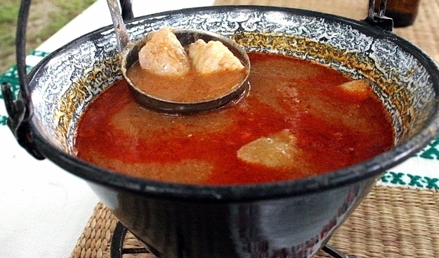
These are tasty and famous Hungarian meals

Slide 18
This is Hortobágy National Park, it is part of the WORLD HERITAGE

Slide 19
The Parliament
Year of construction: 1885-1904
construction style: Gothic Revival , eclectic
Architect: Steindl Imre
Construction cost: 38.000.000 Austro-Hungarian kroners

Slide 20
St. Stephen's Basilica in Budapest

Slide 21
Budapest Eye

Slide 22
This is the Matthias Church in Budapest

Slide 23
Made by:
Zoltán Tölli 6.c
Róbert Hőgye 6.c
Thank you for your attention

